Slide 1
CAR RENTAL SYSTEMS using Full Stack Development
PRESENTED BY :
Sureshmanikandan K
Devanathan A
Raghul Kumar M

Slide 2

TABLE OF CONTENTS
01
03
02
04
OBJECTIVES
APPLICATION
OVERVIEW
TECHNOLOGIES USED
CONCLUSION

Slide 3
OBJECTIVES
OUR AIM
To provide a user-friendly and efficient online platform that facilitates the rental of vehicles for short-term use, allowing users to easily find, book, and manage rental cars while streamlining the rental process for vehicle owners and rental companies.
THE GOAL
The goal of the Rent Car web application is to offer a user-friendly online platform that simplifies the vehicle rental process for users . It aims to provide an easy and efficient way for users to search for, book, and manage rental cars, while ensuring secure transactions and comprehensive vehicle information.

Slide 4
TECHNOLOGIES USED :
FRONTEND: Html Css Bootstrap React Js | BACKEND: Python Django rest framework | DATABASE: MySQL

Slide 5
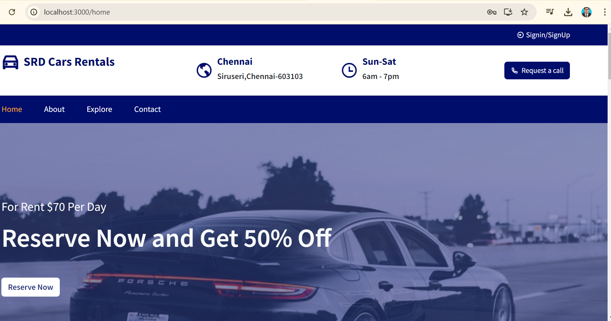
APPLICATION OVERVIEW : HOME PAGE

Slide 6
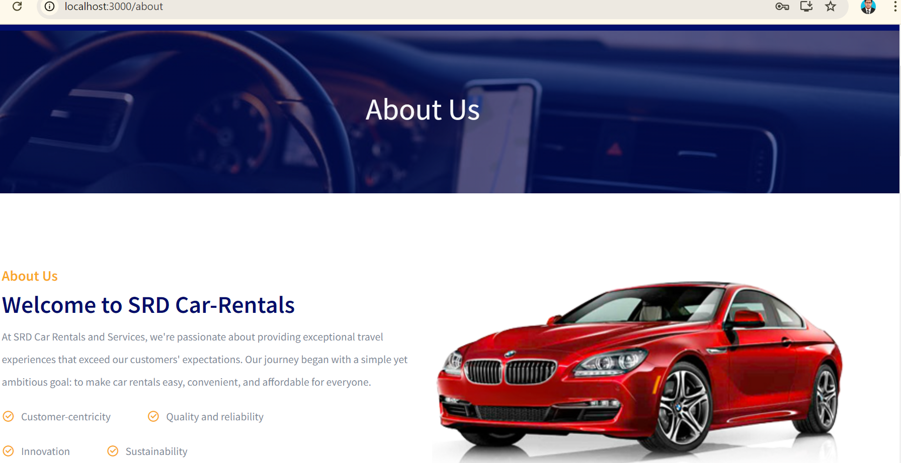
ABOUT PAGE

Slide 7
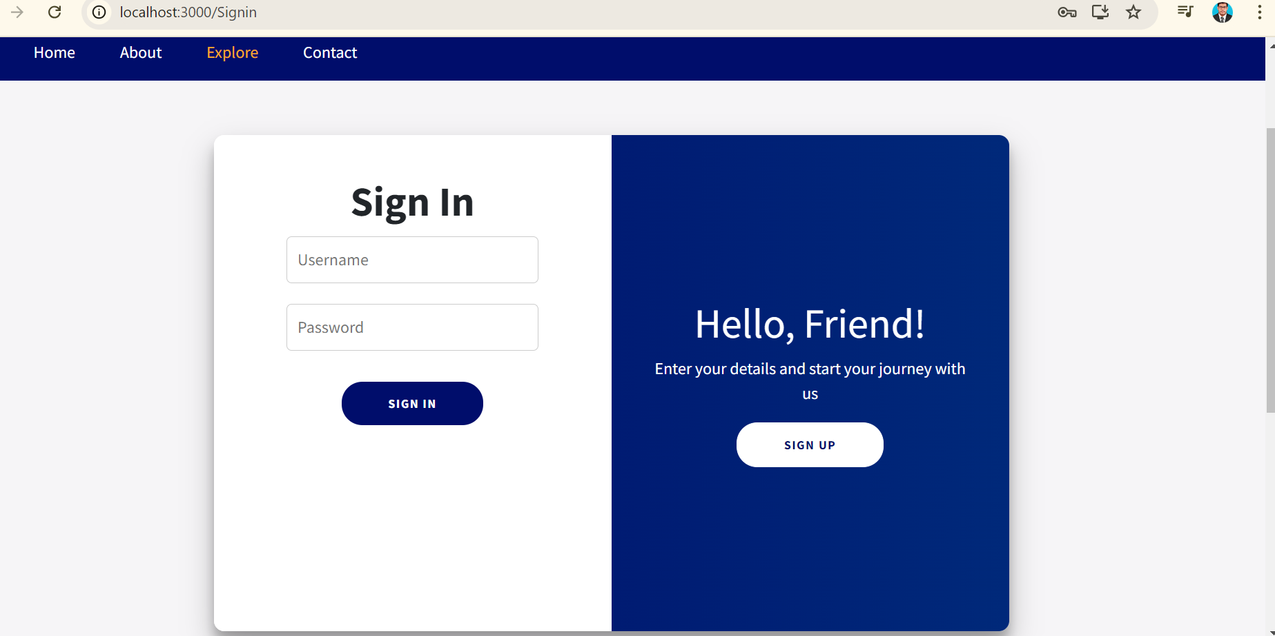
SIGN IN PAGE

Slide 8
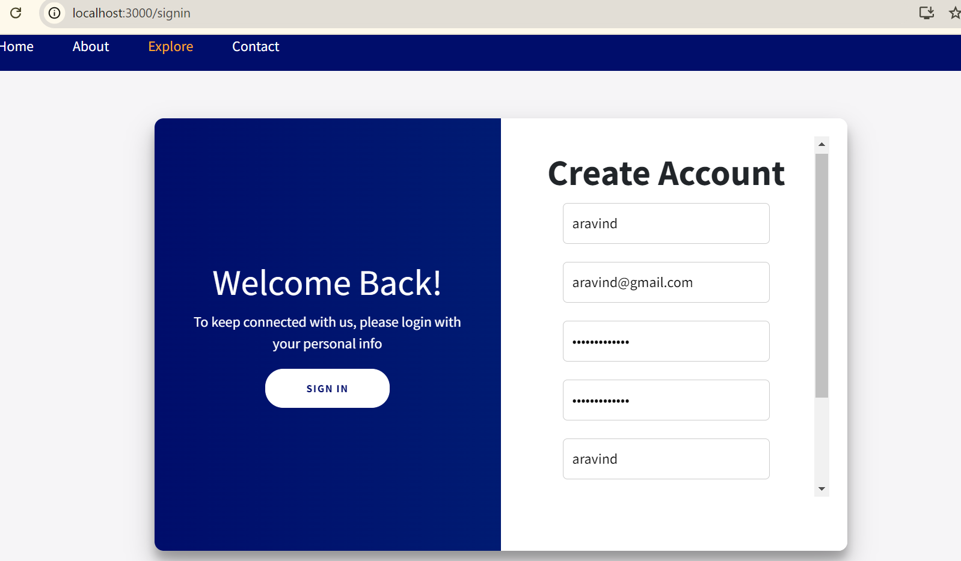
SIGN UP PAGE

Slide 9
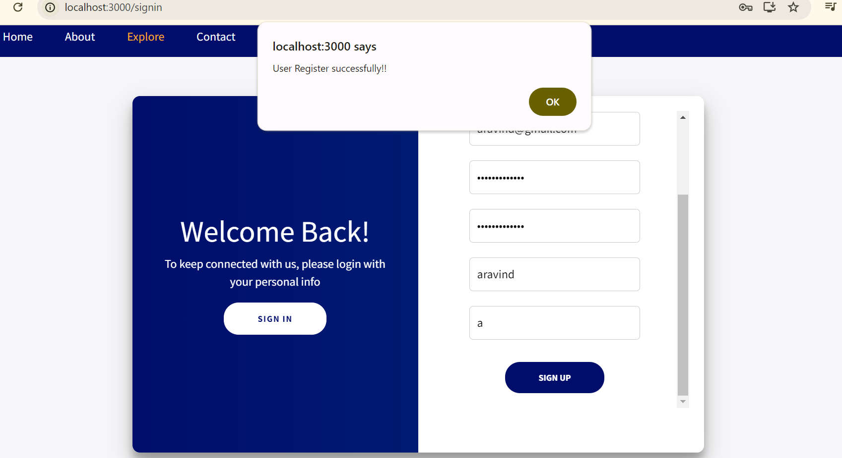
SIGN UP PAGE

Slide 10
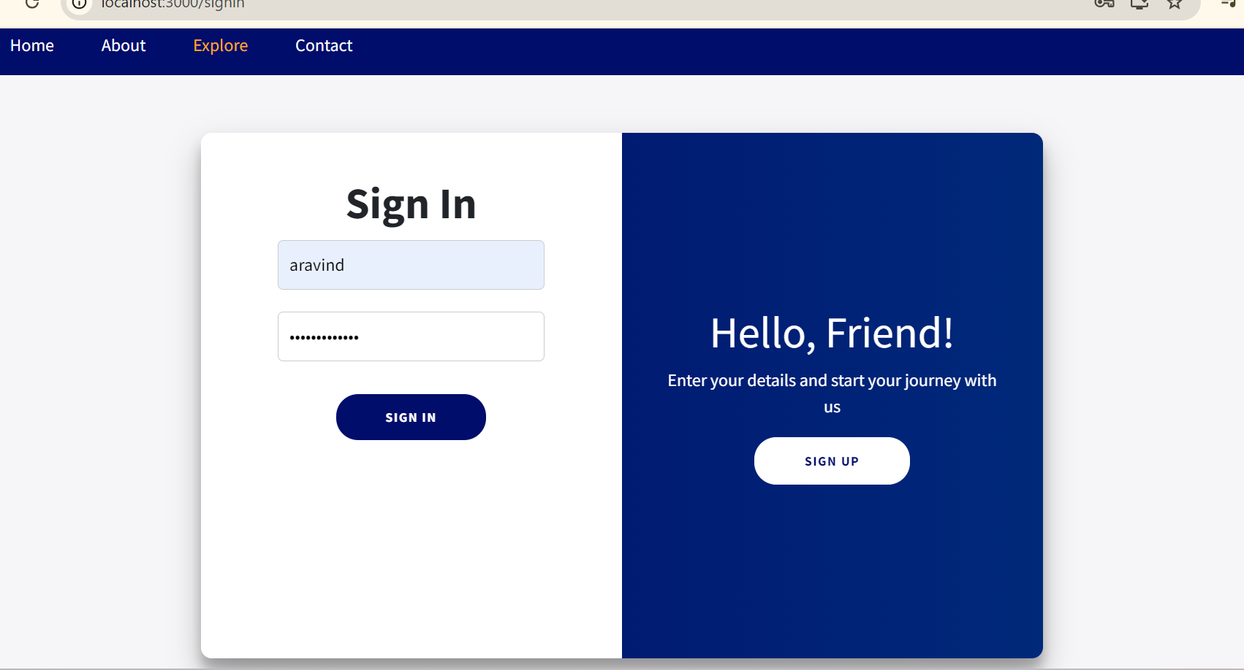
SIGN IN PAGE

Slide 11
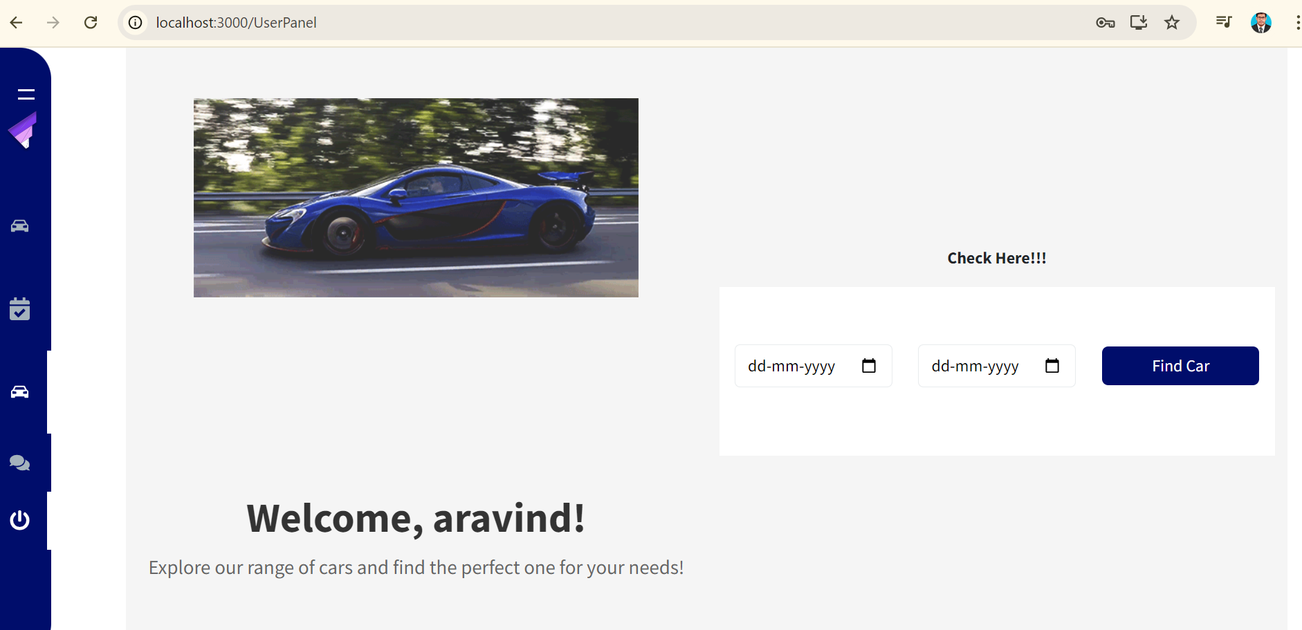
USER PAGE

Slide 12
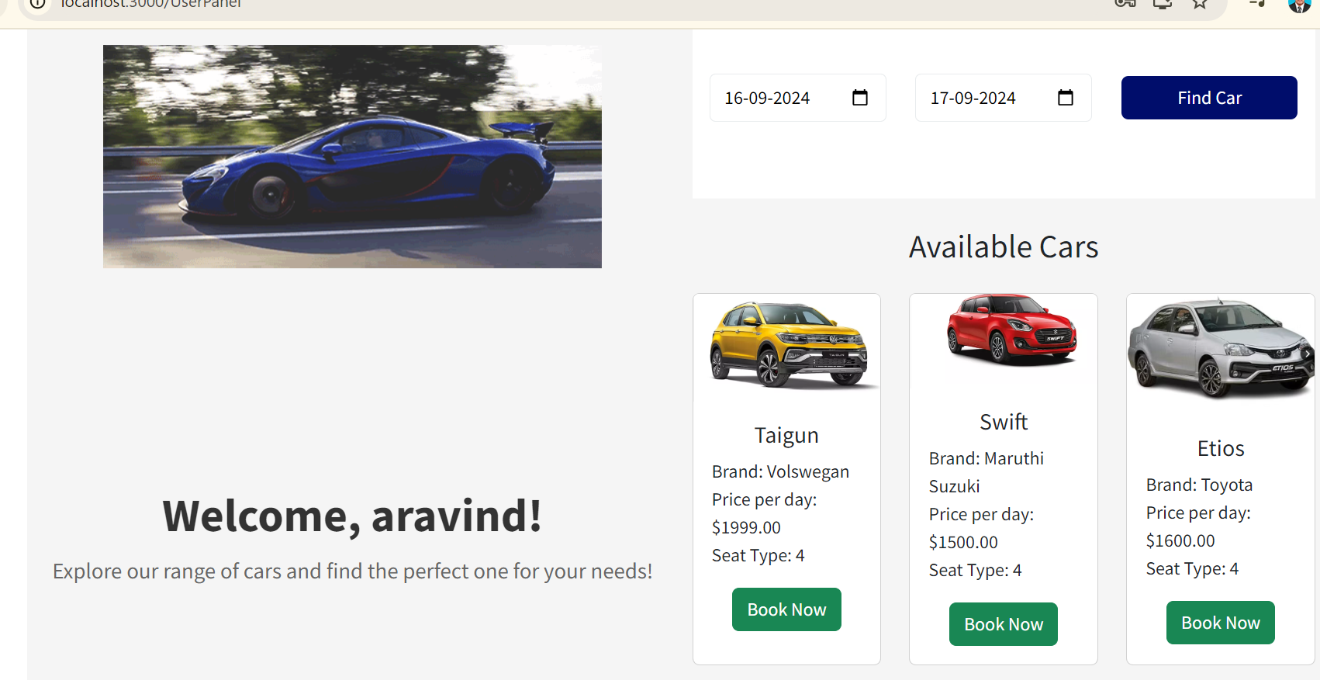
USER PAGE – Find a car

Slide 13
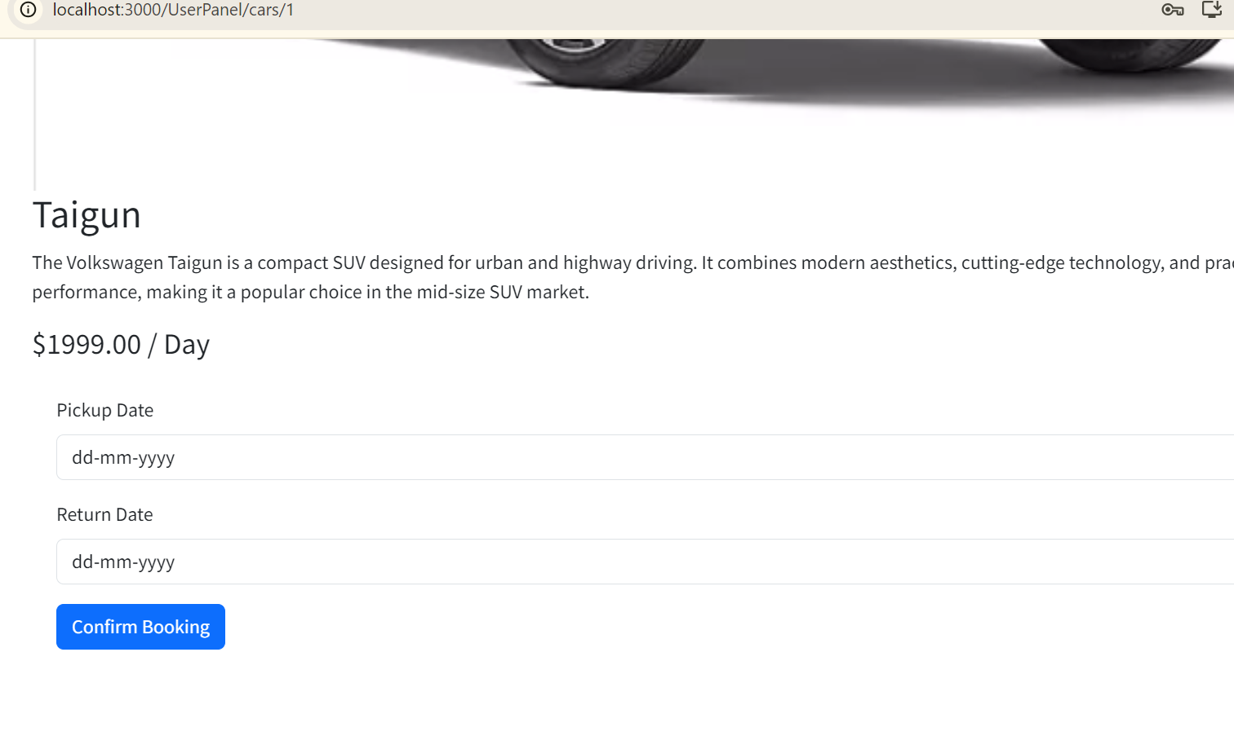
USER PAGE – Confirm Booking

Slide 14
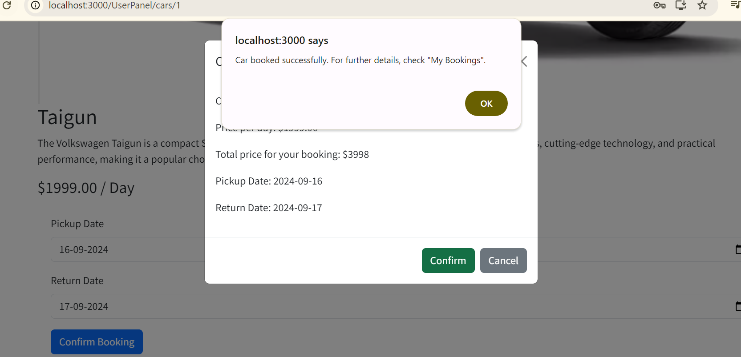
USER PAGE – Booking Success

Slide 15
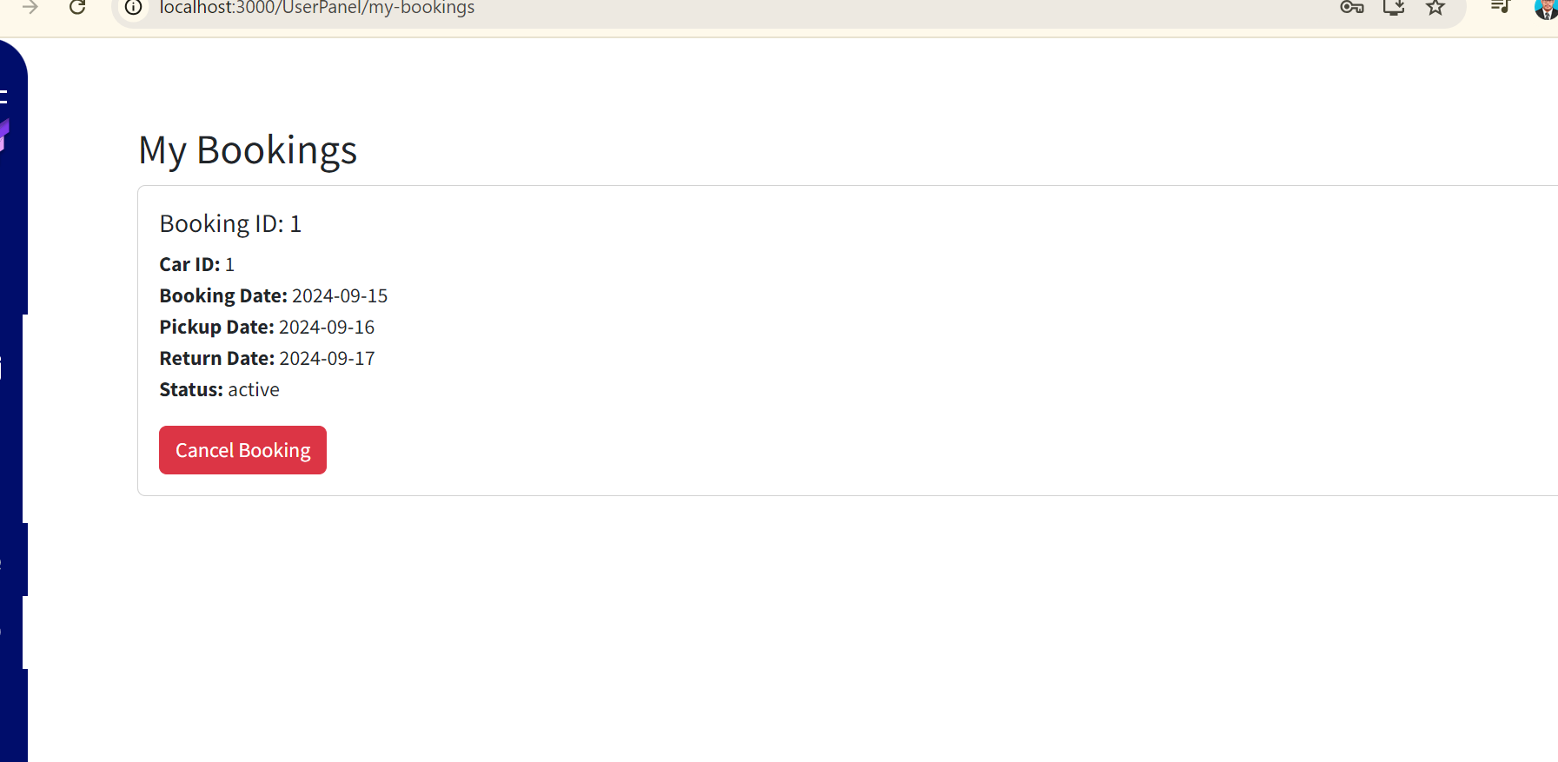
USER PAGE – cancel booking

Slide 16
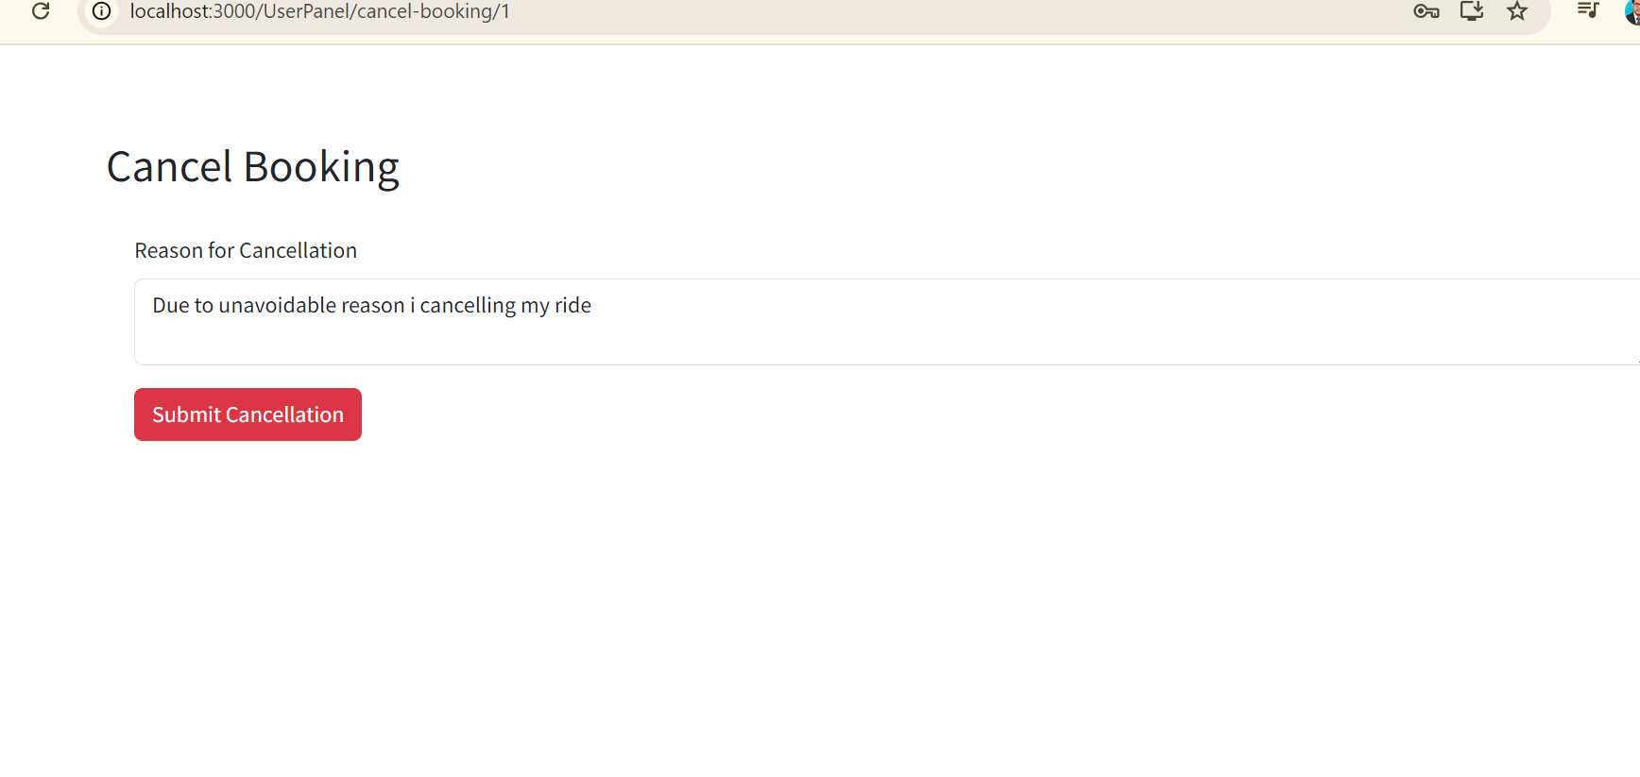
USER PAGE – cancel booking

Slide 17
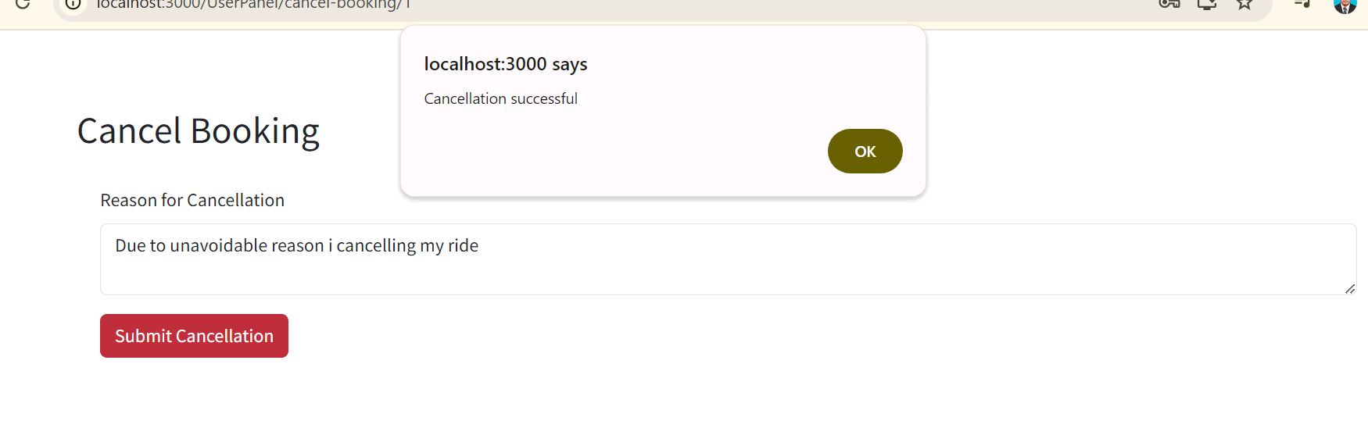
USER PAGE – cancel booking succesful

Slide 18
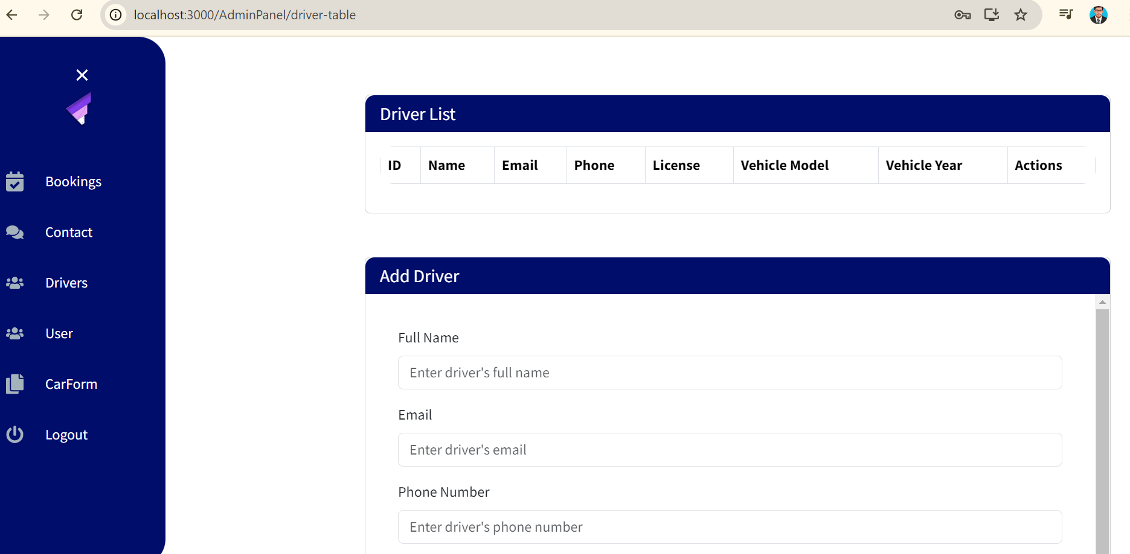
ADMIN PANEL

Slide 19
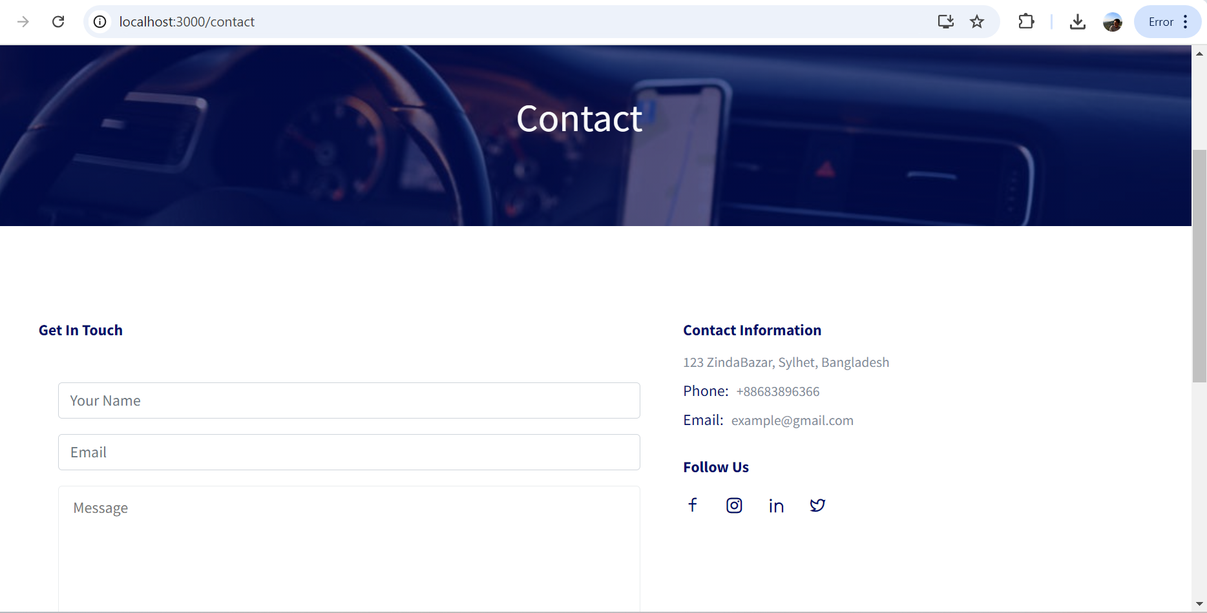
CONTACT PAGE

Slide 20
CONCLUSION
The Car Rental System offers a seamless user experience with an intuitive interface that simplifies car search, booking, and payments.
Admins can efficiently manage bookings, car availability, and cancellations, ensuring smooth and reliable operation.
The system dynamically updates car availability based on bookings and cancellations, preventing double bookings and improving reliability.
With JWT tokens and secure authentication, user data is protected, ensuring data integrity and privacy
The project’s modular design using React and Django makes it scalable, allowing for future enhancements such as new features and service expansion.

Slide 21
THANKS!

